Slide 1
Overview of RAN aspects
RWS-180005
3GPP Workshop on IMT2020 submission
24-25 October, 2018
Bruxelles, Belgium
Balazs Bertenyi (Chairman of 3GPP RAN)

Slide 2

Outline
5G vision → 5G NR standards
What is 5G NR
The advent of 5G – 3GPP Release 15

Slide 3
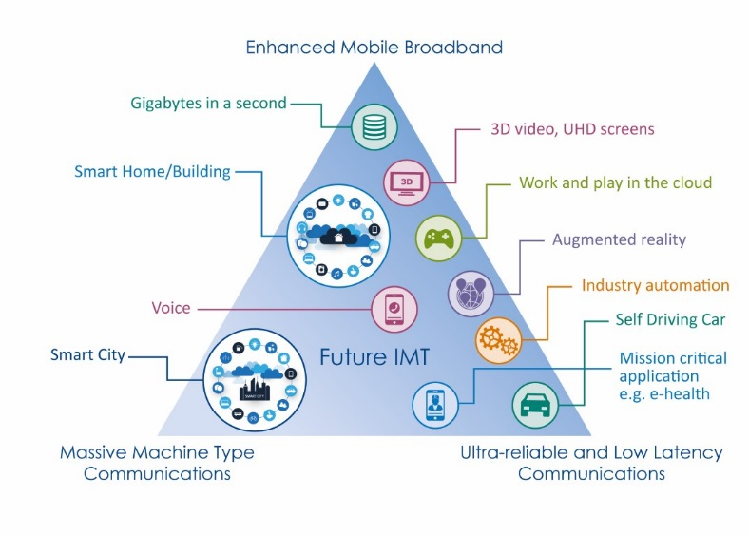
5G vision - at the outset
Gbps bandwidth
10 Mbps/m2 traffic density
True ms latency
99,999% reliability
1 million devices/km2

Slide 4
5G vision - for real
Perfect storm of multiple technology breakthroughs:
Low latency radio with fully flexible network
Artificial Intelligence and Automation
Device revolution for AR/VR
Vertical industries going wireless

Slide 5
5G vision → 5G NR

Slide 6

What is 5G NR ?
Operation from low to very high bands: 0.4 – 100Ghz
  Including standalone operation in unlicensed bands
Ultra wide bandwidth
  Up to 100MHz in <6GHz
  Up to 400MHz in >6GHz
Set of different numerologies for optimal operation in different frequency ranges

Slide 7
What is 5G NR ?
Native forward compatibility mechanisms
New channel coding
  LDPC for data channel, Polar coding for control channel
Native support for Low Latency and Ultra Reliability
Flexible and modular RAN architecture: split fronthaul, split control- and user-plane
Native end-to-end support for Network Slicing

Slide 8
Release 15 – the advent of 5G

Slide 9
Timeline
2017
2018
2019
2020
Q4
Q1
Q2
Q3
Q4
Q1
Q2
Q3
Q4
Q1
Rel-15 NSA (option-3)
freeze
Rel-15 NSA (option-3)
ASN.1
“Main drop”
Rel-15
freeze (incl 5G SA)
Rel-15
ASN.1 (incl 5G SA)
“Late drop”
“Early drop”
Rel-15 late drop freeze
Rel-15 late drop ASN.1
Rel-16 Study phase
Rel-16 Study and Normative phase
Rel-16
freeze
Rel-16
ASN.1

Slide 10

Why the multiple “drops”
“Early drop” for Non-Standalone 5G
  Addresses the most urgent deployment needs for eMBB
    Uses LTE anchor with 5G NR in Dual Connectivity configuration
  Accelerated specification to ensure a single global ecosystem
“Main drop” for Standalone 5G
  Contains full standalone 5G support with 5G Core
“Late drop” for accelerated migration
  Contains specs for all potential migration options

Slide 11
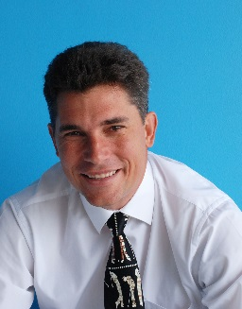
Thank you!
Balazs Bertenyi
Chairman of 3GPP RAN
balazs.bertenyi@nokia.com
+36 20 9849152

